Slide 1
Adding location intelligence to your apps with Bing Maps Enterprise
BRK2390
Ricky Brundritt
Senior Program Manager
Bing Maps
Twitter: @rbrundritt

Slide 2






Agenda
New REST APIs
Data Platform
Map Controls
Open Source
Q & A

Slide 3
Key announcements
Distance Matrix GA
New Services preview – GA timelines and coverage
UWP RS3 update
Project Hurghada timelines
SDS Toolkit OSS release

Slide 4
Bing Maps: New REST APIs

Slide 5

Release Announcement: Distance Matrix API

Slide 6
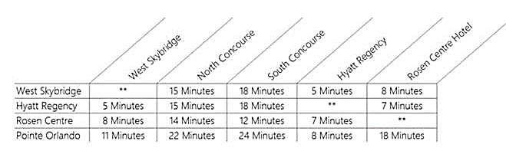
Distance Matrix API – Official Release October 2nd
Calculate travel times and distances between a set of origins and destinations.
Coverage: Most places Bing Maps supports routing
Predictive traffic
Supports driving, walking and public transit
Travel-time histogram in 15 minute intervals
Walking Times

Slide 7
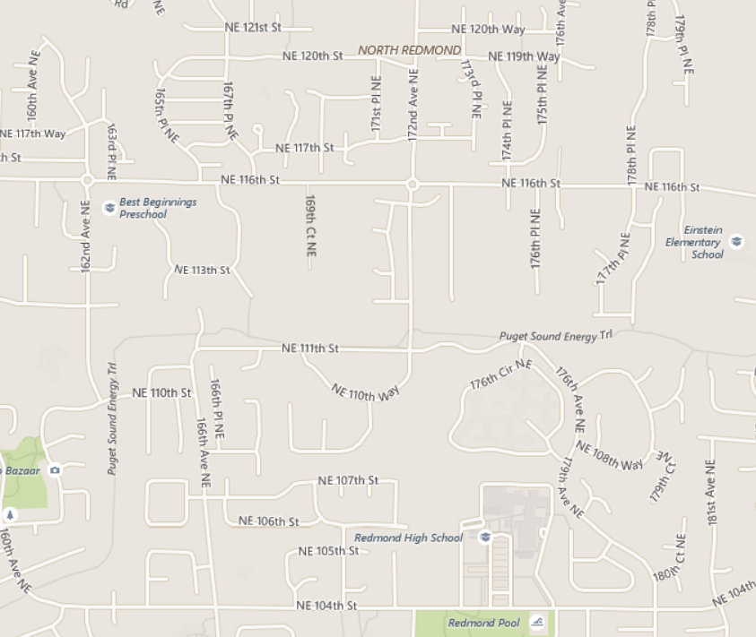
Sort results based on travel time or distance
Which is faster to get to?
Implementations:
Store locators
Job search sites
Location scoring
# | Straight-line Distance (miles) | Driving Distance (Miles) | Driving Time (min)
 | 0.26 | 1.4 | 6
 | 0.76 | 1.1 | 4
2
1
2
1
The further straight line location is faster and closer to get to when driving.

Slide 8
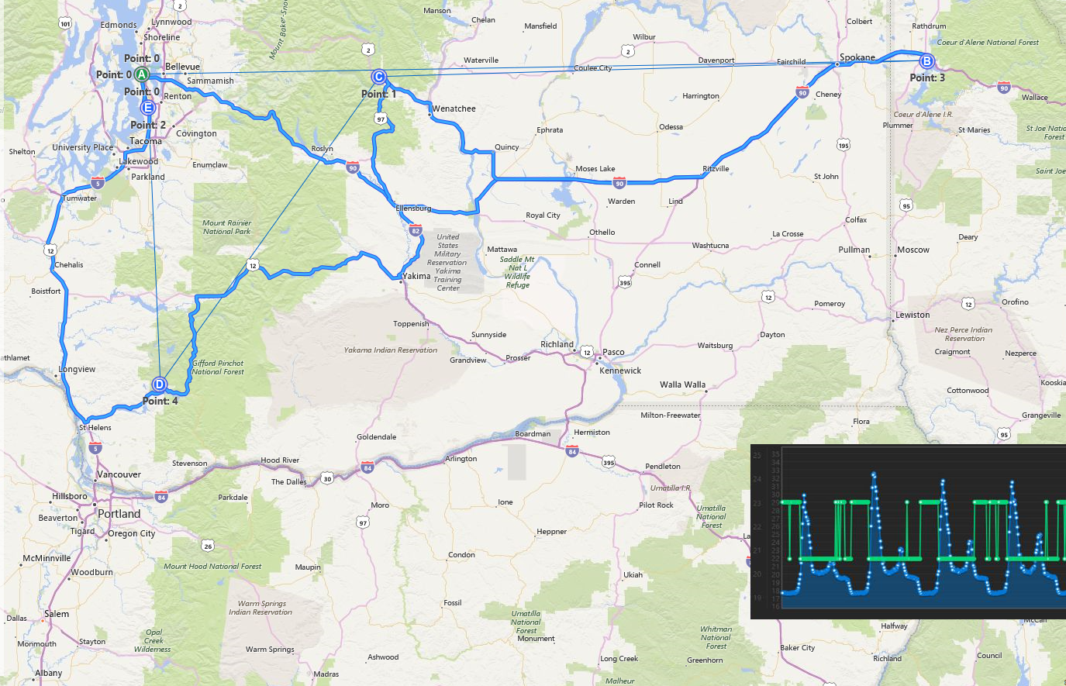
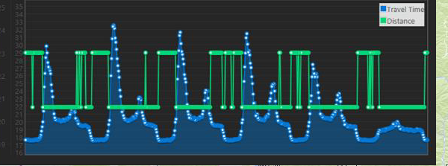
Power Route Optimization Calculations
Types of Route Optimizations
Travelling Salesmen Problem (TSP) – single user
Vehicle Routing Problem (VRP) – fleet of vehicles
Route Optimization Considerations
Time Windows
Pickup and Delivery locations
Vehicle Capacity
Multiple depots
Split deliveries
Backhauls
Notes:
Bing Maps currently does not provide any route optimization algorithms as there is no one algorithm that suits all customer scenarios.
Route Opt. Cond. – There are many different flavors of route optimizations meant to solve different types of scenarios. Here are some things to consider:
Time windows – Need to be at certain locations within certain time windows. Alternatively, if you calculate a histogram of distance matrix data you may find that there is a lot of traffic to a certain location during a certain time of day and that you may want to target a delivery time when traffic isn’t as busy.
Pickup and Deliveries – Does the vehicle need to stop somewhere to pick up an item before delivering it?
Vehicle capacity - There is only so much a vehicle can load, one vehicle may not be able to carry all the items for all locations.
Multiple depots – Is there more than one location where a vehicle can be dispatched out of?
Split deliveries – An order for one location can be split between multiple vehicles and delivered separately.
Backhauls – Does the vehicle need to pick something up and bring it back to the depot?

Slide 9
Additional common Distance Matrix scenarios
Determine Arrival Times based on travel times
When will my pizza get here?
Data Analysis
We are looking to move to a new office, what is the impact on commute times for our staff?
Data Clustering
Group locations based on their travel time or distance closeness to each other. i.e. Find all homes that are within 1 mile of a corner store.

Slide 10
New Bing Maps REST APIs: Services in Preview Preview data limited to USA

Slide 11


Truck Routing API
Calculate routes that can be specifically traveled by trucks and commercial vehicles.
The number of truck trailers
The truck height
The truck length
The truck width
The maximum allowed truck weight
Hazardous goods that are transported by the truck
The category of tunnels that the truck can travel on
The truck's weight per axle

Slide 12
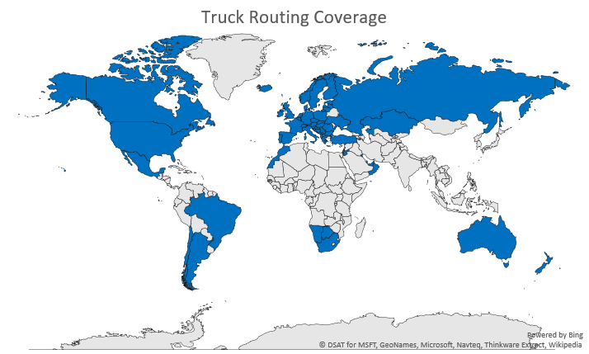
Truck Routing API
Target Release ETA: Q4 2017
Coverage in 59 Countries when released
Albania
Argentina
Australia
Austria
Bahrain
Belgium
Bosnia and Herzegovina
Botswana
Brazil
Bulgaria
Canada
Chile
Croatia
Czech Republic
Denmark
Estonia
Finland
France
Germany
Greece
Hungary
Iceland
Ireland
Israel
Italy
Jordan
Kazakhstan
Kosovo
Kuwait
Latvia
Lithuania
Luxembourg
Macedonia
Mexico
Montenegro
Morocco
Namibia
Netherlands
New Zealand
Norway
Oman
Poland
Portugal
Qatar
Reunion
Romania
Russia
Serbia
Slovakia
Slovenia
South Africa
Spain
Sweden
Switzerland
Turkey
Ukraine
United Arab Emirates
United Kingdom
United States

Slide 13
Demo: Truck Routing API
Ricky Brundritt

Slide 14
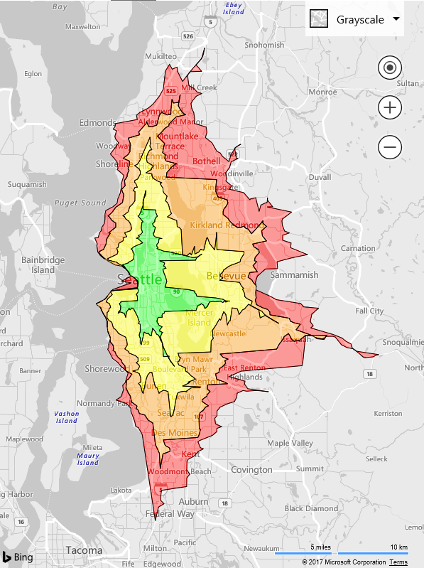
Isochrone API
Calculate the area that can be travelled to within a specified distance or time.
Travel time or distance polygon
Supports driving, walking and public transit
Predictive traffic
Target Release ETA: Q4 2017
Coverage: Most places Bing Maps supports routing
10 minutes
15 minutes
20 minutes
25 minutes

Slide 15
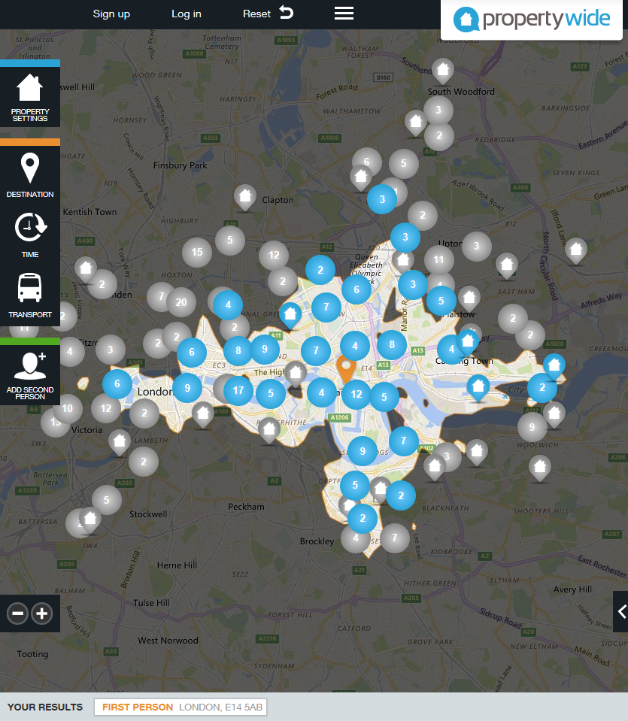
Common Isochrone scenarios
Time based searches
Stolen Vehicle Recovery
Real Estate
Law Enforcement
School Zone and Bus Planning
Dating sites
Geofence Generation
City Planning

Slide 16
Demo: Property Wide Travel Time Search Real Estate Portal Achieves 300 Percent Jump in Conversion Rates Using Commute Time Search

Slide 17
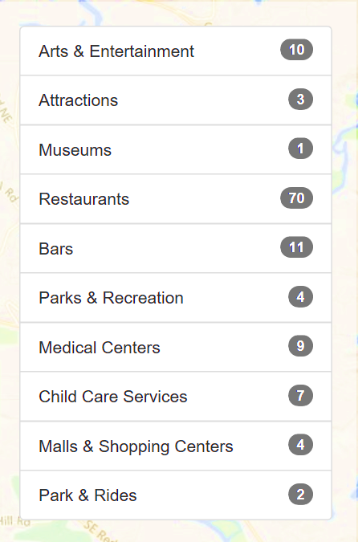
Local Insights API
Scores the attractiveness of a location based on proximity to points of interest.
Supports driving, walking and public transport
Common Scenarios
Real Estate
Commercial Real Estate
Target Release ETA: Q4 2017
Coverage: Initially USA, and expanding over time.

Slide 18
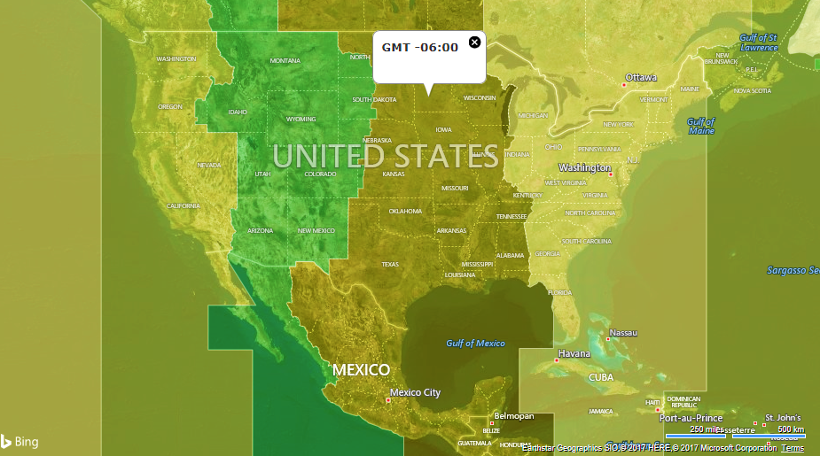
Time Zone API – Coming soon
Find the time zone info for any location on the globe.
Features:
DST offset
Current time from epoch
Polygon boundaries
Time zone metadata
Target Release ETA:
Spring 2018

Slide 19
Bing Maps: Data Platform

Slide 20
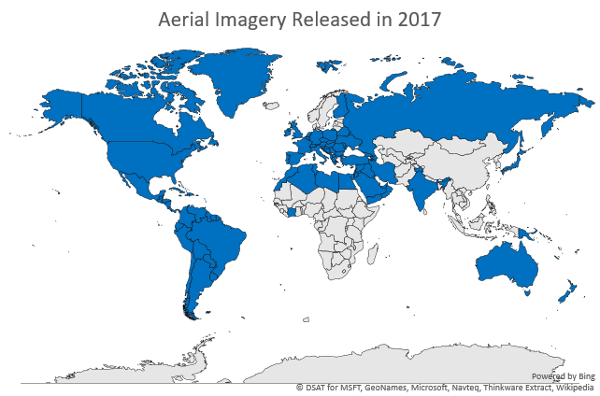

Aerial Imagery
Updating all aerial imagery in Bing Maps globally
114M sq KM of new imagery released… so far

Slide 21
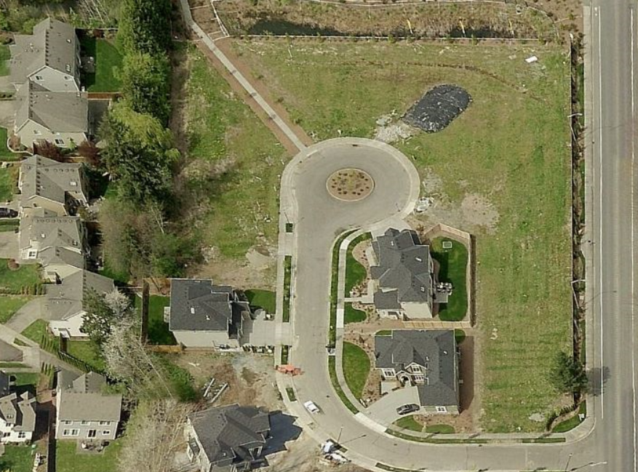

Birds Eye Imagery
New imagery released covering 451 cities
Resolution: 7.5-10cm
241K sq KM in North America
14K sq KM in outside of North America
Before
After

Slide 22
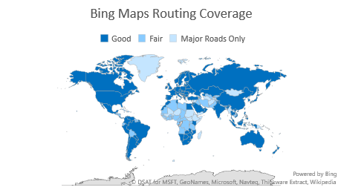
Geocoding and Routing
New backend geocoder deployed in March
Improved search logic
Allows for faster updates
Seamless upgrade behind the scenes for Bing Maps APIs
Increased routing support from 140 countries to 174.

Slide 23
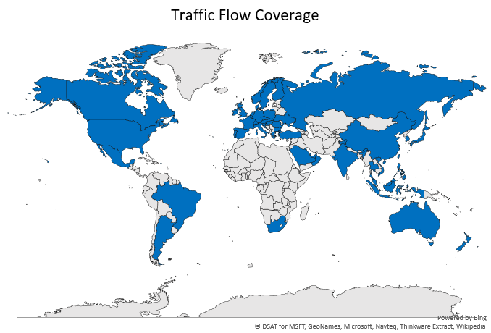
Traffic Coverage
Expanded coverage from 35 to 55 countries in the past year.
Real-time and predictive traffic based routing available everywhere that Bing Maps has traffic flow data.
Notes:
Detailed Coverage Information: https://msdn.microsoft.com/en-us/library/jj136866.aspx

Slide 24
Bing Maps: Maps Controls

Slide 25
Map Controls: Bing Maps V8 Web Control

Slide 26
Bing Maps V8 Web Control
High Performance HTML5 based Map control
Easily develop with JavaScript or TypeScript
Access features early through the experimental branch
High Performance Renders 10x more data
Developer Friendly
Less code needed to write your app
Feature Rich Lots of features that align with developer feedback

Slide 27
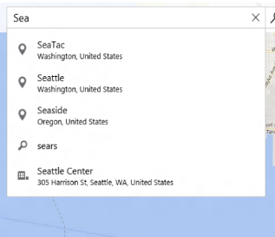
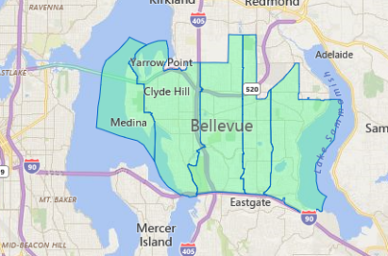
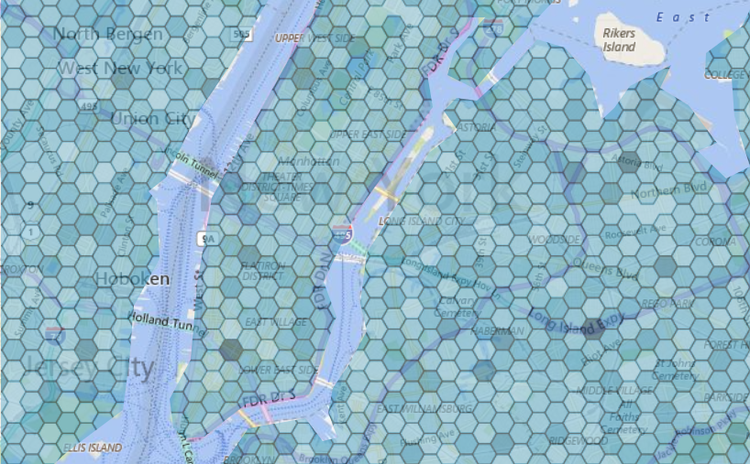
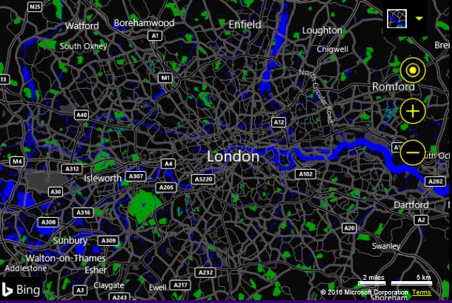
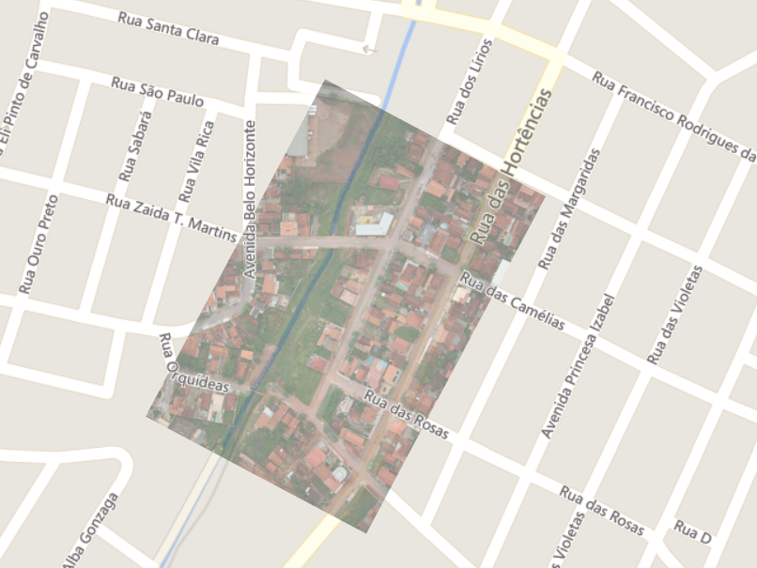
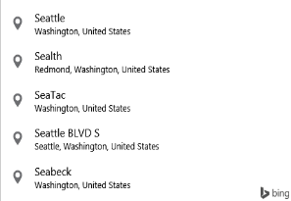
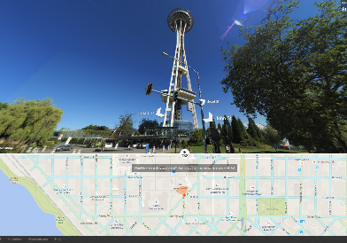
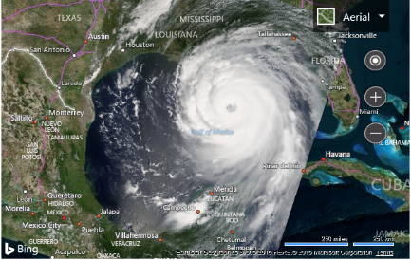
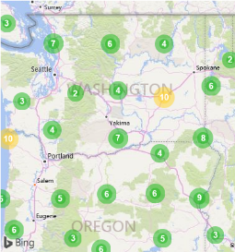
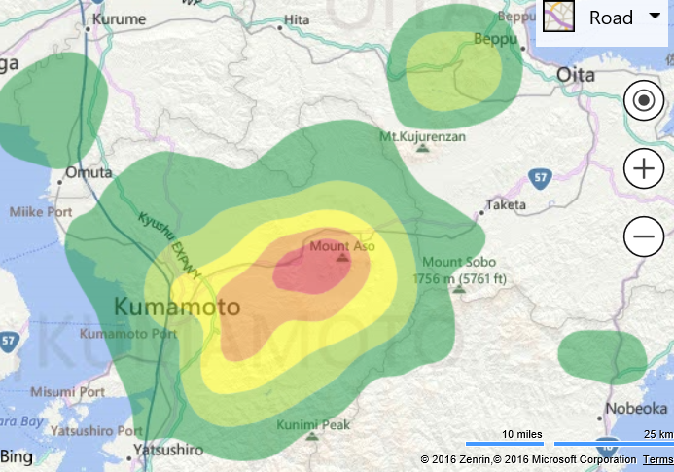
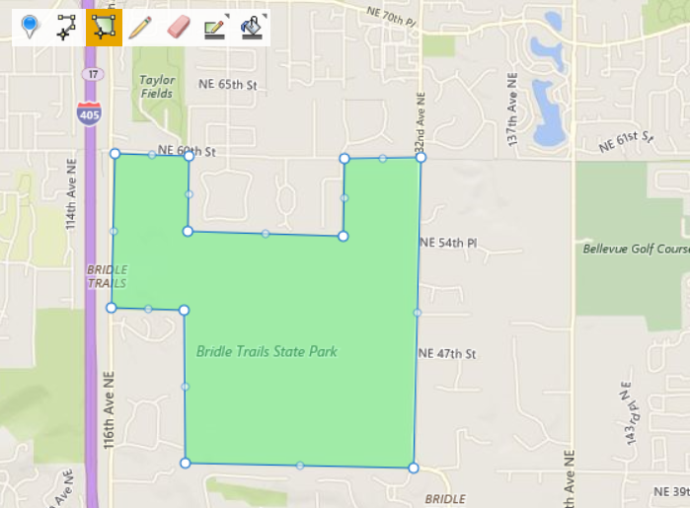
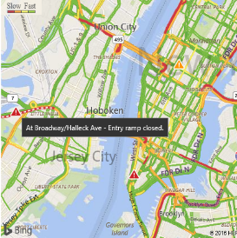
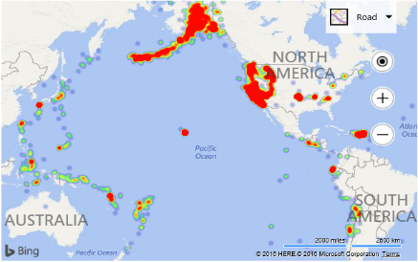
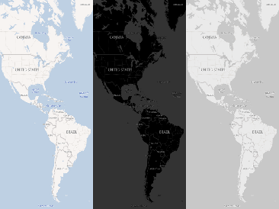
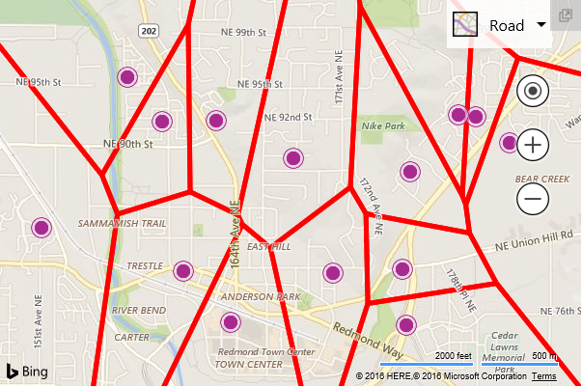

Bing Maps V8 Web Control features
Autosuggest
Boundary Data
Data Binning
High Contrast Support
Ground Overlays
Streetside Imagery
Vector Labels
Clustering
Contour Lines
Drawing Tools
Traffic
Heat maps
New Map Styles
Spatial Math Library
Birdseye Imagery
Notes:
In the past, apps that implemented maps required someone who was a “mapping developer”. With the Bing Maps v8 SDK, Microsoft’s modern web mapping platform, this is no longer the case and adding a map to an app is as easy as adding a chart or other standard control. The Bing Maps v8 SDK reduces development time by requiring less code to implement more functionalities. It also brings significance performance improvement. For instance, the Bing Maps SDK uses the HTML5 canvas, which provides a significant rendering performance boost over other map controls. In addition, in response to our developer community’s demand, a number of exciting new features such as Autosuggest, Streetside imagery, and many business intelligence tools have been added.
High Performance - The Bing Maps V8 Web control is HTML5 powered and is one of the fastest web map controls available on the market. It’s over 10 times faster at rendering data than previous versions and capable of rendering tens of thousands of shapes.
Developer Friendly – The V8 SDK has been optimized so as to minimize the amount of code needed to develop apps. It is significantly backwards compatible with V7.
Feature Rich – The Bing Maps V8 control has more than double the number of features of previous versions and has a lot more features being developed. The new features in this web control were selected based on 5 years of customer feedback. As such V8 better aligns with the type of apps customers and developers are trying to build with Bing Maps.

Slide 28
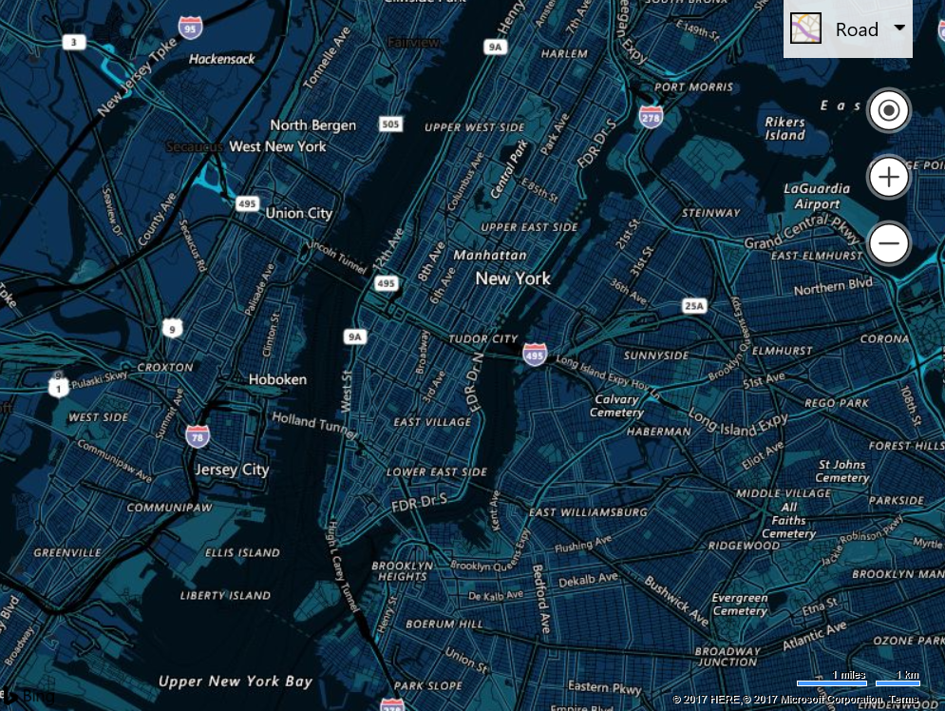
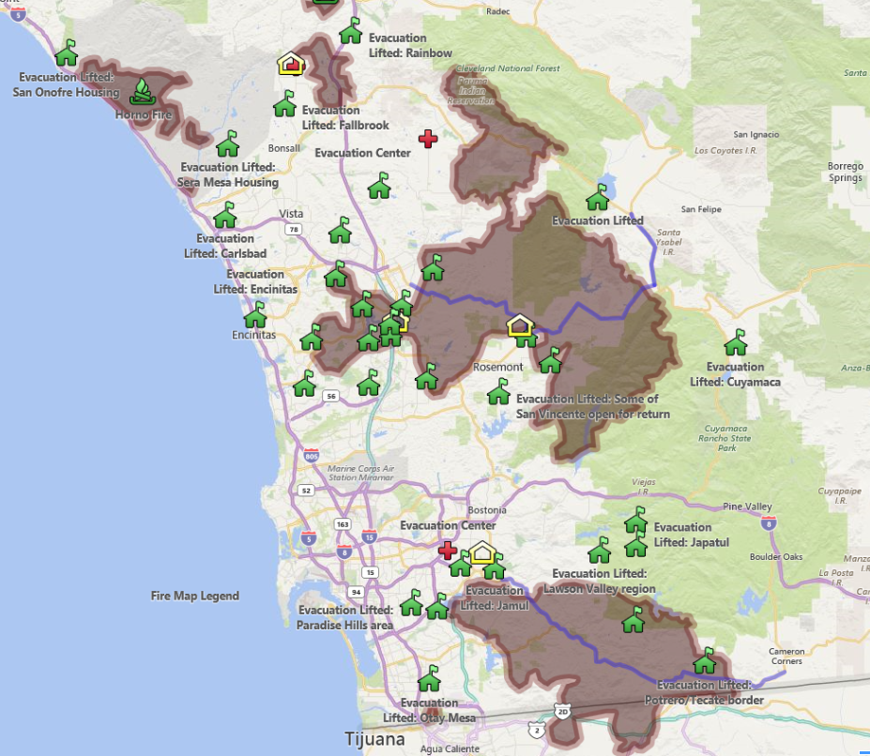
New Features
Custom Map Styles
Fully customize the look and feel of the map with a custom map style.
GeoXml Module
Easily import and export KML, KMZ, GPX, GeoRSS, and GML data with Bing Maps with as little as 3 lines of code.

Slide 29
Demo: Bing Maps V8 Web Control
Ricky Brundritt

Slide 30
Map Controls: Windows 10 UWP

Slide 31

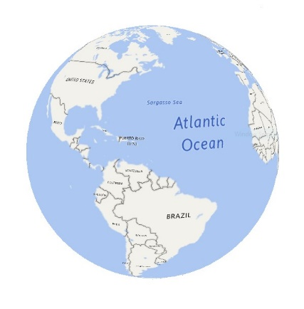
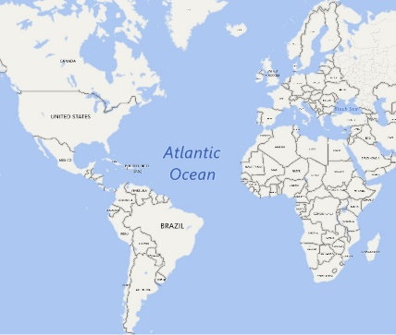
Windows 10 UWP - Creators Update (RS2)
Released in Spring 2017
Key new features:
Custom map styling
Offline map improvements
MapBillboard (dynamically scaled pushpin)
2D/3D Projection Support
Notes:
Offline improvements – Mobile device management support such that admins can force devices to download maps ahead of time. Support for taking custom areas offline rather than full states/countries.

Slide 32
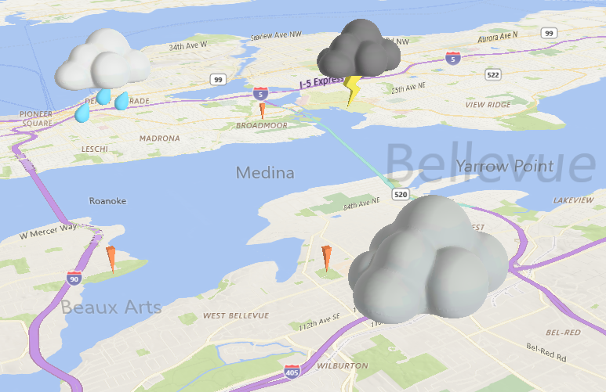
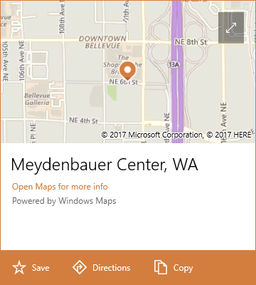
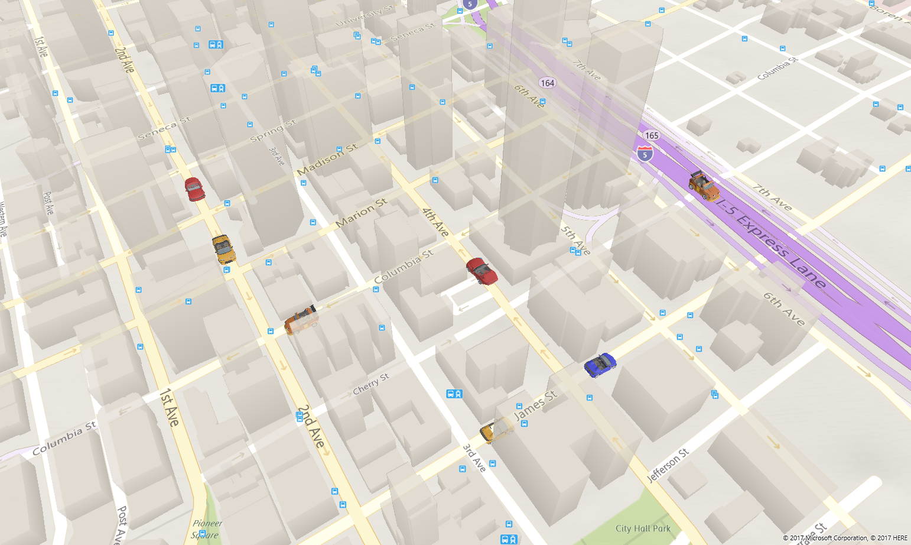
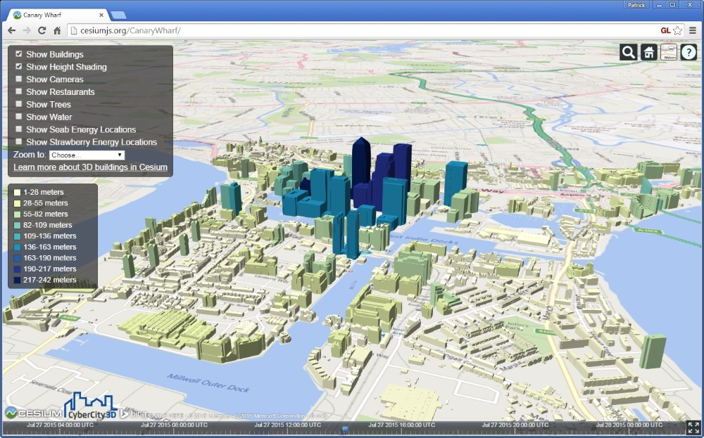
Windows 10 UWP – Fall Creators Update (RS3)
Many map improvements coming in the Fall Creators Update
Key Features:
3D building improvements
Custom 3D model support
Support for Layers
Place Info API

Slide 33
Demo: Windows 10 UWP Maps
Ricky Brundritt
Notes:
Have a 3D truck follow a GPX trace.

Slide 34
Bing Maps: Open Source

Slide 35
Bing Maps Open Source
Open Source Projects
REST Toolkit for .NET (Jan 2017)
Bing Maps V8 TypeScript definitions (Aug 2016)
V8 Code Samples (March 2017)
Bot Framework Location Picker (Dec 2016)
Spatial Data Services Toolkit for .NET (Sept 2017)
Project Hurghada (Oct 2017)
Microsoft Maps Spatial Toolbox
Open V8 Modules
Map Style Editor
Released in the past year
Coming Soon
Considered for FY18

Slide 36
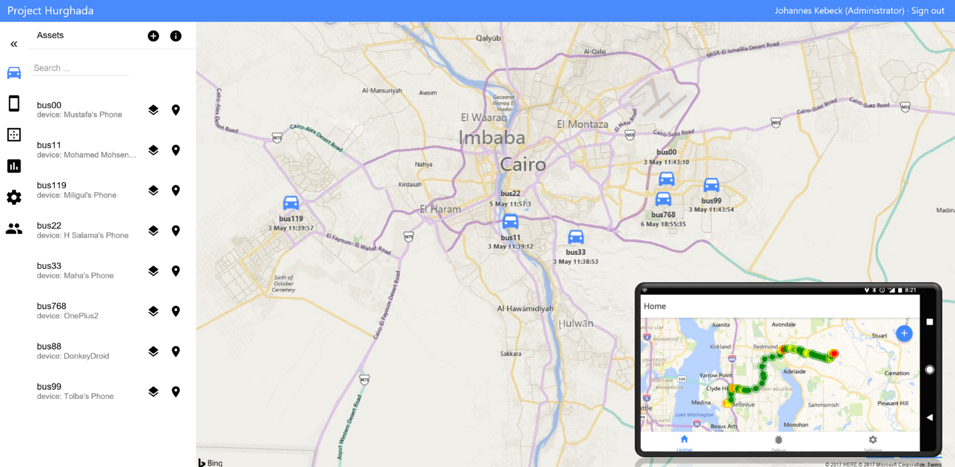
Project Hurghada – Coming soon!
An open source vehicle tracking solution for small to medium sized teams.
Features:
Easily track mobile devices
Current and historical view
Geofences
Truck Routing
Analytics
Target Release ETA: October 2017

Slide 37
Demo: Project Hurghada
Ricky Brundritt
Notes:
http://projecthurghadademo.azurewebsites.net

Slide 38
Q & A
Ricky Brundritt, Senior Program Manager – Bing Maps
richbrun@microsoft.com
@rbrundritt
Session Code Samples and Resources
https://aka.ms/BingMapsIgnite2017

Slide 39

Please evaluate this session Your feedback is important to us!
This slide is required. Do NOT delete or alter the slide.
The slide will be replaced onsite through Silver Fox Productions with an updated QR code.
From your PC or Tablet visit MyIgnite at http://myignite.microsoft.com
From your phone download and use the Ignite Mobile App by scanning the QR code above or visiting https://aka.ms/ignite.mobileapp

